Slide 1

New Graph Approach to Biovista Primitives
Andrew Westlund

Slide 2
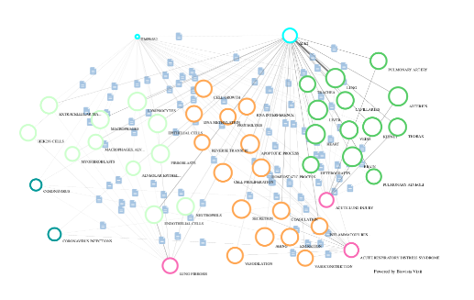
BACKGROUND
Biovista’s Project Prodigy is an AI engine that processes a large graph of published papers to develop diagnoses and proposed treatment plans for complex illnesses.
Biovista has challenged ORU’s computing faculty to develop improved graph processing capabilities.

Slide 3

MOTIVATION
Biovista’s update process to incorporate new publications takes ten days.
At any given time, Biovista’s analytics are at least that much out of date.
A means to incrementally update the data would solve this.

Slide 4
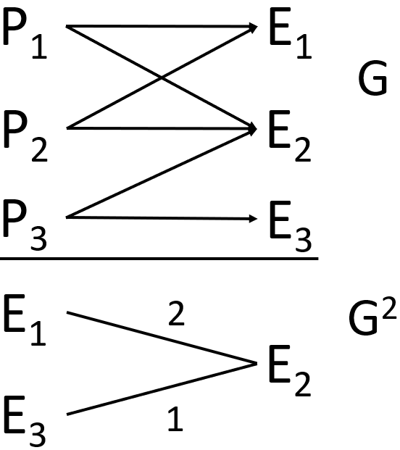
OBJECTIVES
Build the solution using ORU’s AGILE graph framework.
Creation of the initial G² in a timely manner.
Update G² into G²’ in less than ten milliseconds per paper.
Primitives’ performances are at least comparable to their original versions.

Slide 5
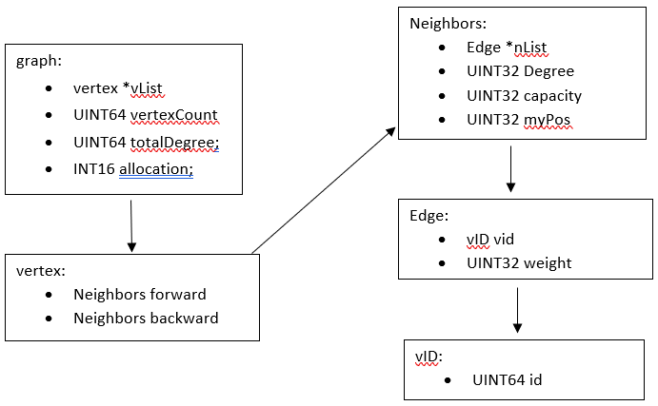
Building G
Scan in a binary file to an array of edges.
Use multiple threads and assign each thread a range of entities.
Create an array of AVL trees so that each entity has its own tree.
Insert the paper to the entity’s tree in O(log₂(n)).
Traverse through each AVL in order and add each edge in O(1).

Slide 6
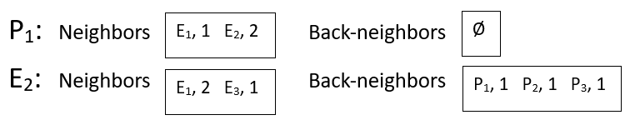
Squaring G
Two entities referenced by the same paper have a co-occurrence (cooc).
A cooc’s magnitude is the number of papers the two entities share.
The threads and the AVL trees are reused.
Each AVL tree inserts an entity’s cooc in O(log₂(n)) time.
Again, each AVL traverses to transfer the coocs to the graph; each edge added takes O(1).

Slide 7
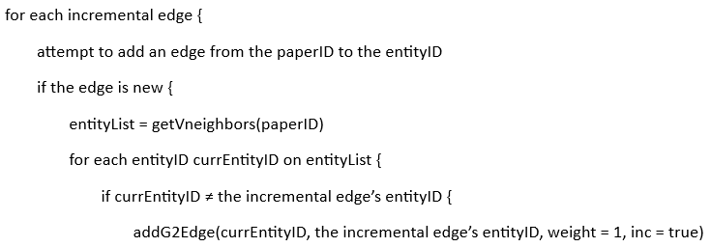
Incrementally Update the Graph
If an edge is added, both G and G² must be updated.
Add the edge from paper to entity.
Add/Update the edge between each pair of entities.

Slide 8
Primitives
Biovista uses primitives to analyze aspects of the entities’ relationships.
Expand, Connect, Bridge, and Bibliography.
Expand: Find the ten entities of a type that cooc with the given entity the most.
Bridge: Find the ten entities of a type that have the greatest combined cooc with both entities.
Primitives are found easily because of the nature of G².

Slide 11
All the objectives have been met.
Key Next Steps
Merge this result with Chilu Mutale’s MariaDB BioVista Storage Engine
A persistent backing store (able to start up instantly from having been shut down)
Client/Server usage model consistent with what they already use.
Implement the means to perform additional Biovista primitives.

